Slide 1

Cloud Security Alliance, MN Chapter
How Do You Manage Compliance, Security & Privacy if Your Sensitive Data is Hosted within a Cloud Infrastructure by a 3rd Party Vendor?
Sponsor Presentations
January 24, 2020

Slide 2
Minnesota Chapter – Cloud Security Alliance
Friday, January 24, 2020
12:30 pm Lunch, Networking
1:00 pm Minnesota Chapter Cloud Security Alliance Updates
Introduction of January Speaker
1:20 pm Guest Speaker: Rick Borden, Chief Legal Officer ORock Technologies
How do you manage Compliance, Security, & Privacy if your Sensitive data is Hosted within a Cloud Infrastructure by a 3rd Party Vendor?
2:45 pm Networking Break
3:15 pm Chapter Meeting Sponsor Presentation –
Thales, Trend Micro, and ORock Technologies
3:30 pm Final Q & A for Presenter / ORock Technologies
3:40 pm – Happy Hour

Slide 3
Cloud Security Alliance, MN Chapter
How Do You Manage Compliance, Security & Privacy if Your Sensitive Data is Hosted within a Cloud Infrastructure by a 3rd Party Vendor?
Keynote Presentation
January 24, 2020

Slide 4
What We’ll Cover
The differences between privacy and security regulation
New regulations that are impacting privacy and security in the U.S.
Where these changes intersect and impact data in the cloud
How businesses should be thinking about management of third-party cloud vendors
CONFIDENTIAL | ©2019 CSA MN Chapter

Slide 5
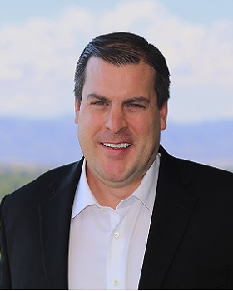

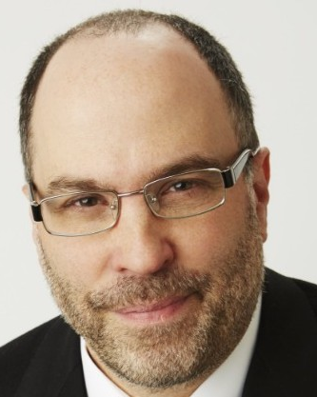


Panelists
Steve Robinson
Chief Revenue Officer
Commercial & Public Sector
ORock Technologies, Inc.
srobinson@orocktech.com
Richard Borden
Chief Legal Officer &
Chief Privacy Officer
ORock Technologies, Inc.
rborden@orocktech.com
Kerry Manaster
Chief Technology Officer &
Chief Privacy Officer
Whitebox Advisors, LLC
kemanaster@outlook.com
CONFIDENTIAL | ©2019 CSA MN Chapter

Slide 6

BREAK / NETWORKING TIME
BREAK / NETWORKING TIME
---15 MINUTES ----
CONFIDENTIAL | ©2019 CSA MN Chapter

Slide 7

Sue Yorkovich - Major Account Manager – MN - Encryption
Randy Fox – Regional Sales Manager – MN Encryption
Jake Bartell – Regional Sales Manager – Midwest - Authentication
Stephen O’Connor - Sr. Systems Engineer – MN

Slide 8
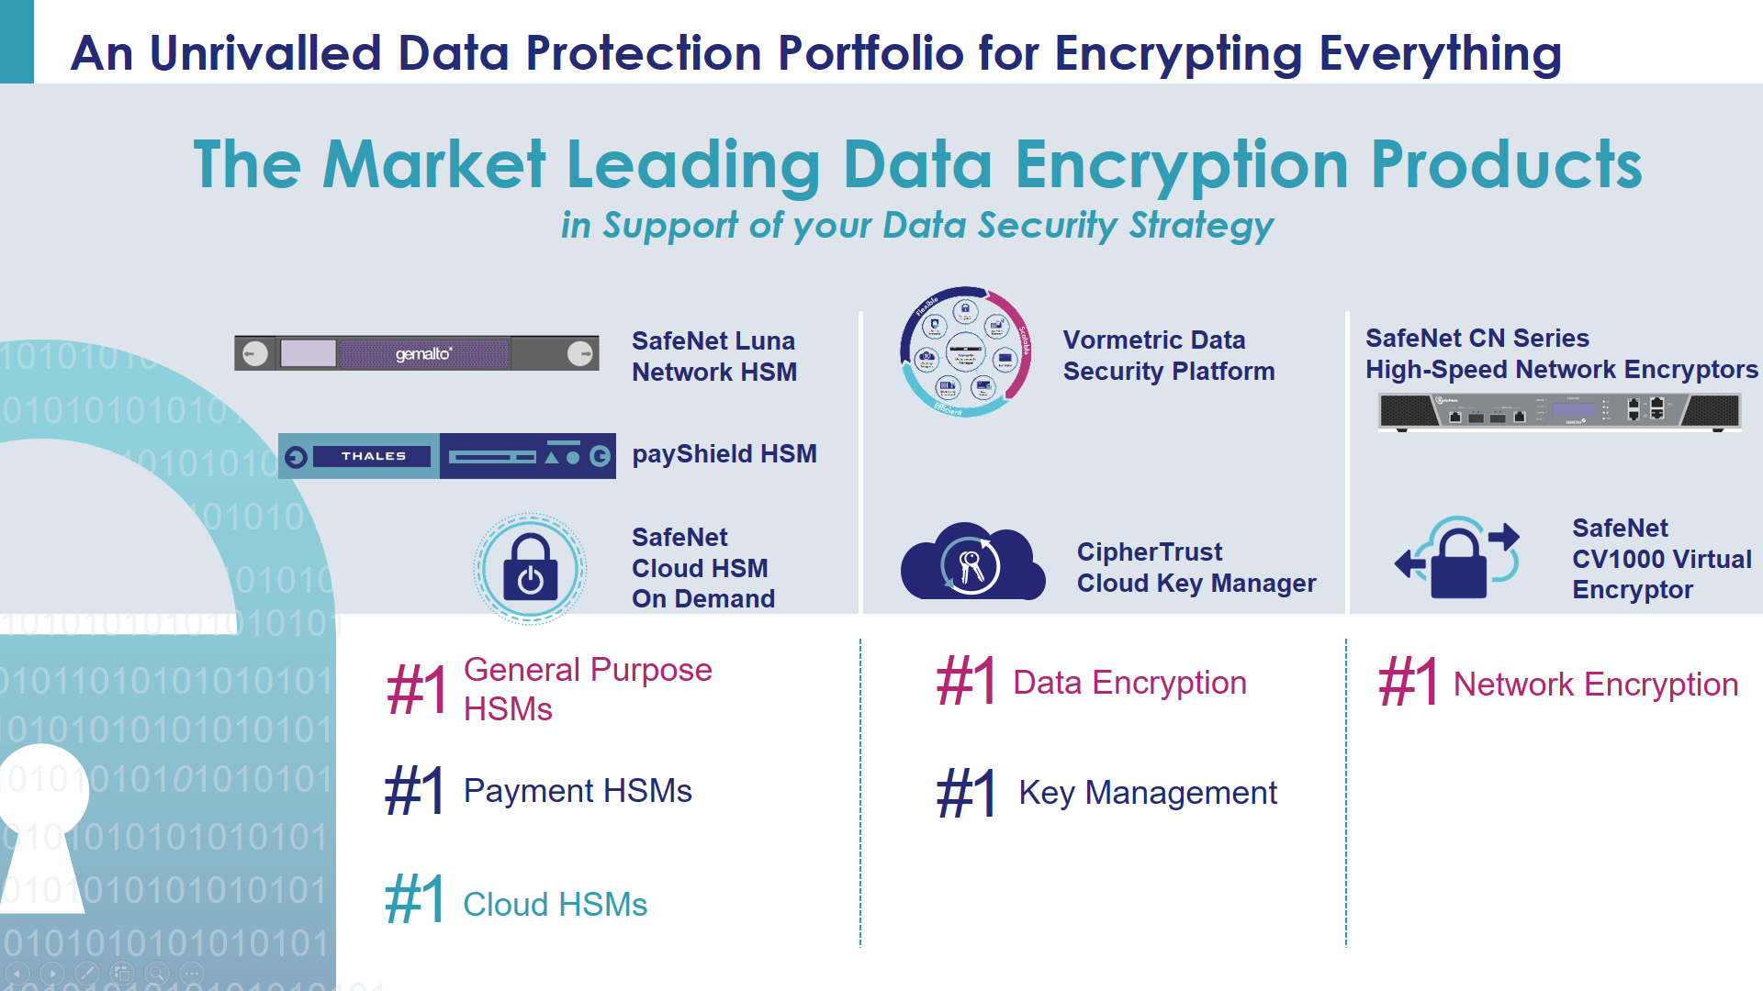
Unrivalled Data Protection Portfolio for Encrypting Everything
CONFIDENTIAL | ©2019 CSA MN Chapter

Slide 9
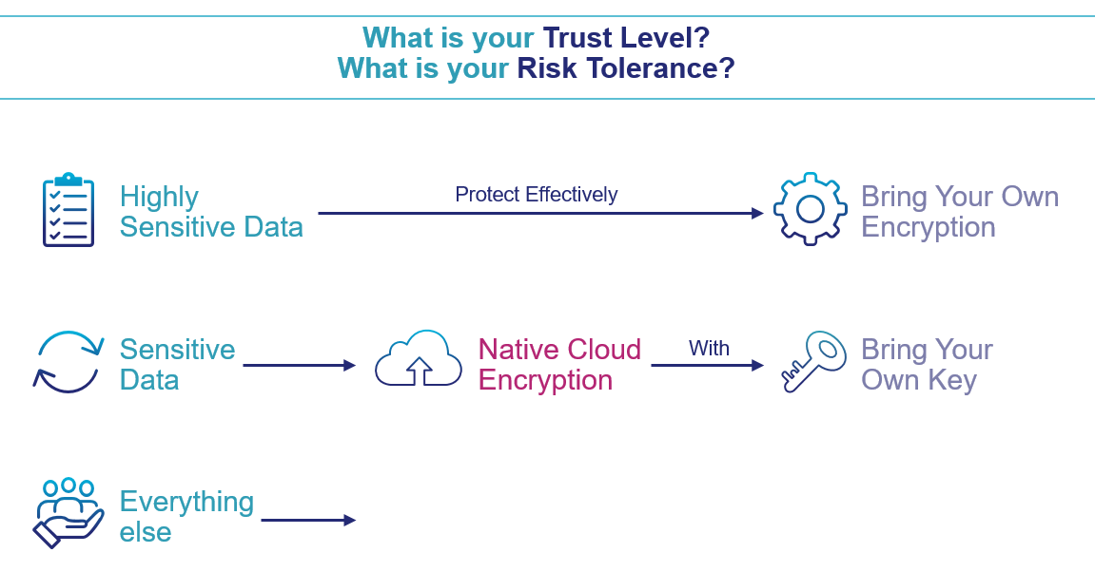
Data Protection Options for the Cloud
CONFIDENTIAL | ©2019 CSA MN Chapter

Slide 10





CipherTrust Cloud Key Manager
Multicloud key life cycle management
  Keys you create
  Cloud-native keys you inherit
FIPS 140-2 certified
  Customer owns original key material for life
Operations efficiency
  Key visibility and usage
  Automation of key rotation
Disaster recovery
  Key escrow
Deployment
  Customer Managed, private deployment
Think of it as…
  A management plane for cloud encryption keys
  A cloud key broker
CONFIDENTIAL | ©2019 CSA MN Chapter

Slide 11



Data Discovery and Classification
Cloud application
VTE agent (remediation)
STA
Data Discovery & Classification Management Console
Data Discovery & Classification Server
Databases
Agentless scan
Tokenized data (remediation)
VTE agent (remediation)
Remediation
Network Attached Shares
Thales Key Manager
Tokenization Server
Vormetric Transparent Encryption
VTE agent (remediation)
HSM for Root of Trust
HSM
On-premises HSM or HSMoD
File server
Scanning agent installed
VTE agent (remediation)
CONFIDENTIAL | ©2019 CSA MN Chapter

Slide 12

LinkedIn – Crypto & Cocktails
Sue Yorkovich – susan.yorkovich@thalesgroup.com
Stephen O’Connor - stephen-s.oconnor@thalesgroup.com

Slide 13
.
Mark Pedersen – Regional Account Manager
Jim Sellinger – Regional Account Manager
Jerry Ramlet – Regional Account Manager

Slide 14
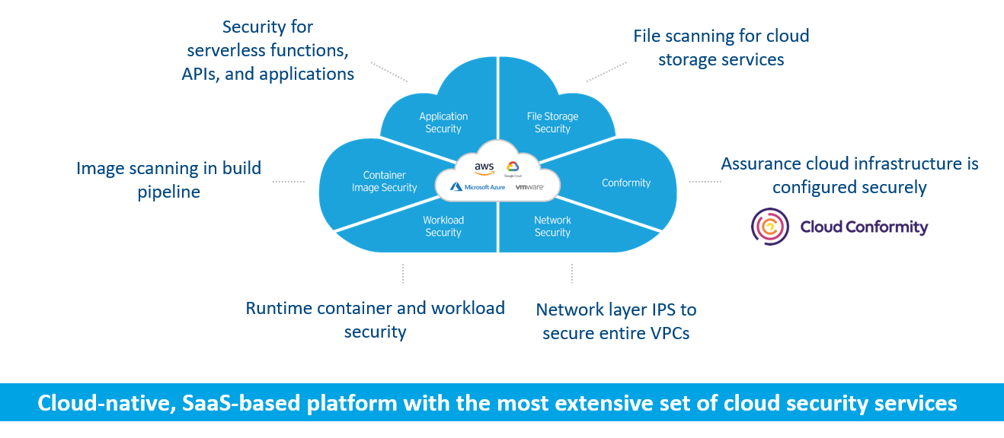
Trend Micro Cloud One™️
Security Services Platform for Cloud Builders
CONFIDENTIAL | ©2019 CSA MN Chapter

Slide 15
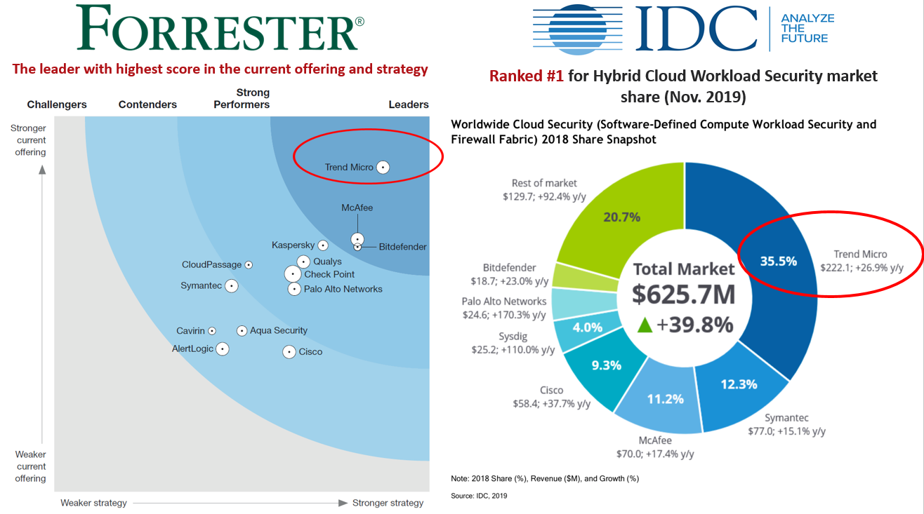

Slide 16
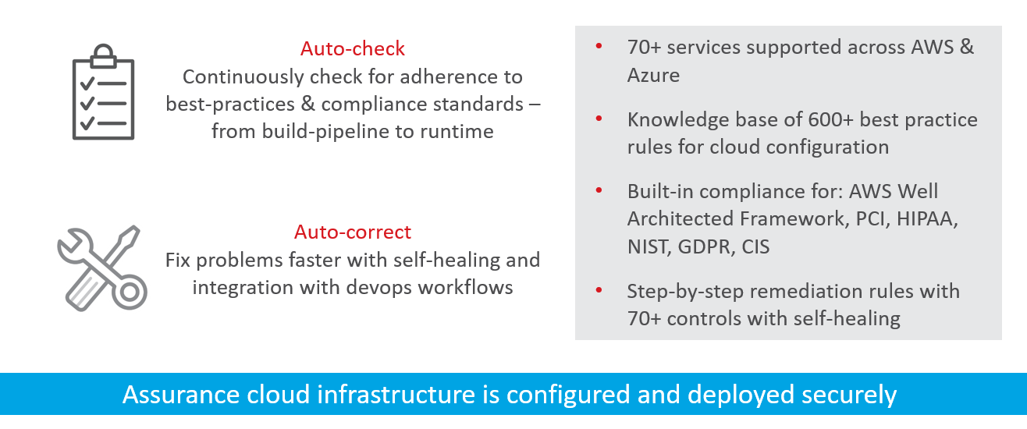
Cloud One – Conformity

Slide 17

ORock Technologies, Inc.
www.orocktech.com | (571) 386-0201 | sales@orocktech.com

Slide 18





Who is ORock Technologies?
Infrastructure Service Provider (ISP)
Private Fiber Optic Backbone Network | HPE Hardware
Cloud Service Provider (CSP)
Enterprise-grade Open Source Environments | Hybrid, Private & Public Clouds
“As a Service” Provider
Secure, Fit-for-Purpose Solutions | IaaS, PaaS & SaaS
CONFIDENTIAL | ©2019 CSA MN Chapter
18

Slide 19



ORock Helps Organizations…
CONNECT
PROTECT
MODERNIZE
On-Premises & Cloud Environments
Sensitive Data at Rest & In Transit
IT Infrastructure & Applications
  Transport data securely
  Operate in multiple clouds or on-prem environments
  Enable Edge computing
  Comply with regulatory requirements
  Identify & respond to cybersecurity threats
  Recover from ransomware attacks
  Transition to Hybrid Cloud
  Shift from CapEx to OpEx
  Implement DevSecOps & container strategies
CONFIDENTIAL | ©2019 CSA MN Chapter
19

Slide 20






Built for Regulated Industries & Government
Security & Performance
Predictability & Control
Data Protection
Private Fiber Optic Network
Enterprise-Grade Open Source
Flat-Rate Billing
White-Glove Support
Compliance
325+ security controls
Encrypted network
SOC 2 Type II data centers
HPE Silicon Root of Trust
HPE Supply Chain Responsibility Program
Transport data at Layer 2
Dedicated connectivity between all ORock network PoPs
No upstream CSP
Connections terminate in ORock cages
No vendor lock-in
Interoperable, vendor-agnostic environment
Built with Open Source tools
NO data egress fees
Simplified, predictable billing
No surprise charges or inflated exit costs
U.S.-based NOC & SOC
Staffed by US citizens
Single point of contact for 24/7/365 customer service
Flexibility and agility
FedRAMP Moderate (Authorized) or High (Ready)
DoD Impact Level 2
HIPAA/HITECH
PCI DSS
Support for regulatory reporting
www.orocktech.com | sales@orocktech.com | (571) 386-0201
CONFIDENTIAL | ©2019 CSA MN Chapter
20

Slide 21
Closing Comments
Any final Q & A for Presenters / Panelists?
Any final Q & A for Sponsors?
Next Meeting is: March 20, 2020. Watch our web site and your email for additional details for Topic and Location.
Please stay for additional networking, food, drinks, and social hour!
THANK YOU FOR YOUR ATTENDANCE!
CONFIDENTIAL | ©2019 CSA MN Chapter

